Slide 1
ACCREDIA The Italian National Accreditation Body
ISO 37001
Anti-bribery management systems
Guidelines for Accreditation
Dr. Emanuele Riva
ACCREDIA - Director of the Dept. of Certification and Inspection
IAF – Vice Chair

Slide 2
Introduction to ISO 37001
In most jurisdictions, it is an offence for individuals to engage in bribery and there is a growing trend to make organizations as well as individuals liable for bribery.
Nevertheless, the law alone is not sufficient to solve this problem.
Notes:
2

Slide 3
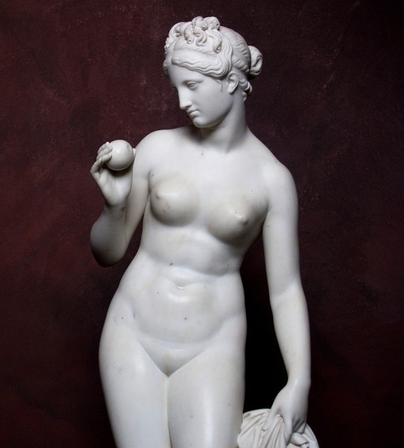

Slide 4


Slide 5
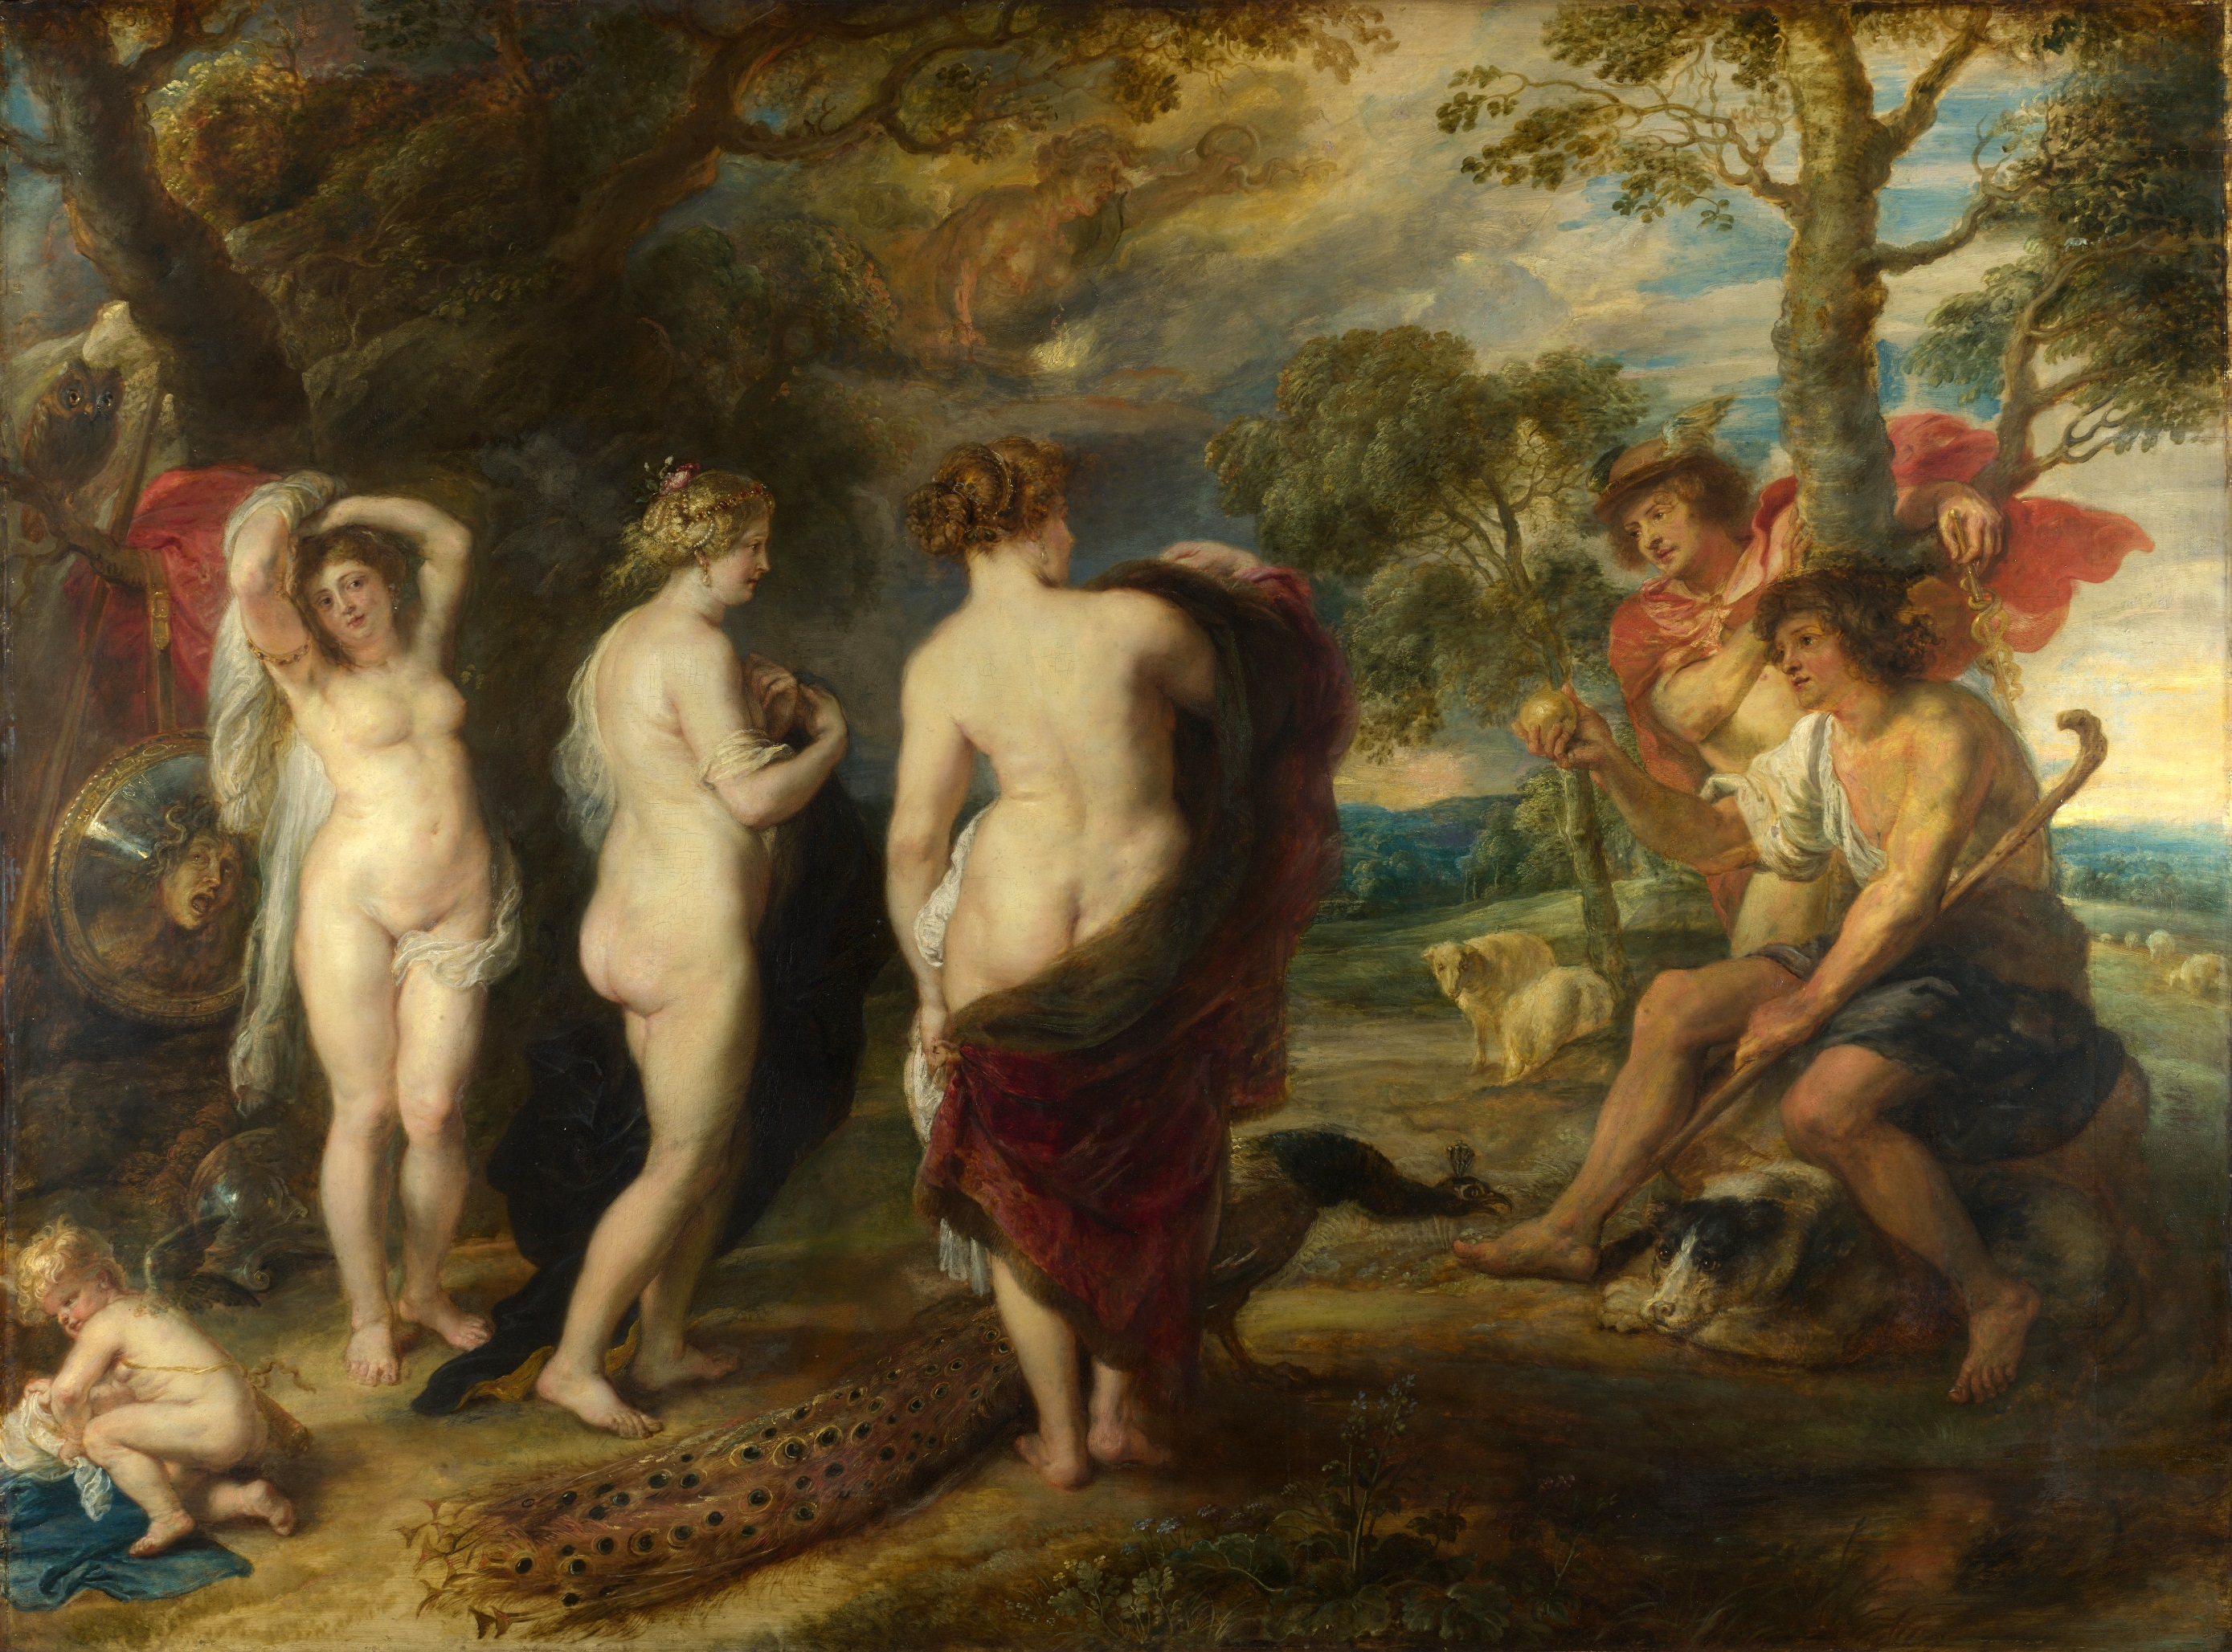
ACCREDIA L’ente italiano di accreditamento

Slide 6
Why is so difficult to evaluate ISO 37001?
Looking for a super auditor!
A corrupt company is often conspiratorial. (A.3.1 Bribery is normally concealed. It can be difficult to prevent, detect and respond to. )
It is required high competence o the auditors, to undestand the dinamics of bribaries
We are getting close to the job of companies that perform financial audits… so maybe we should get closer to their strategies and rules
Notes:
6

Slide 7
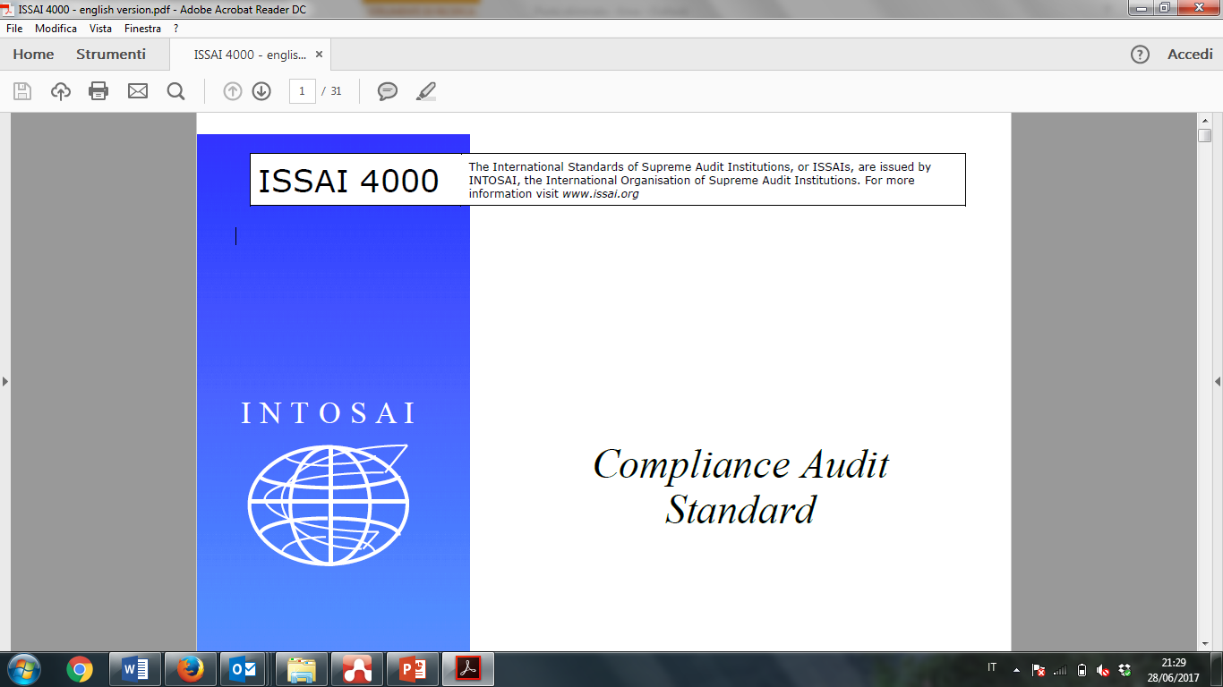
Notes:
7

Slide 8
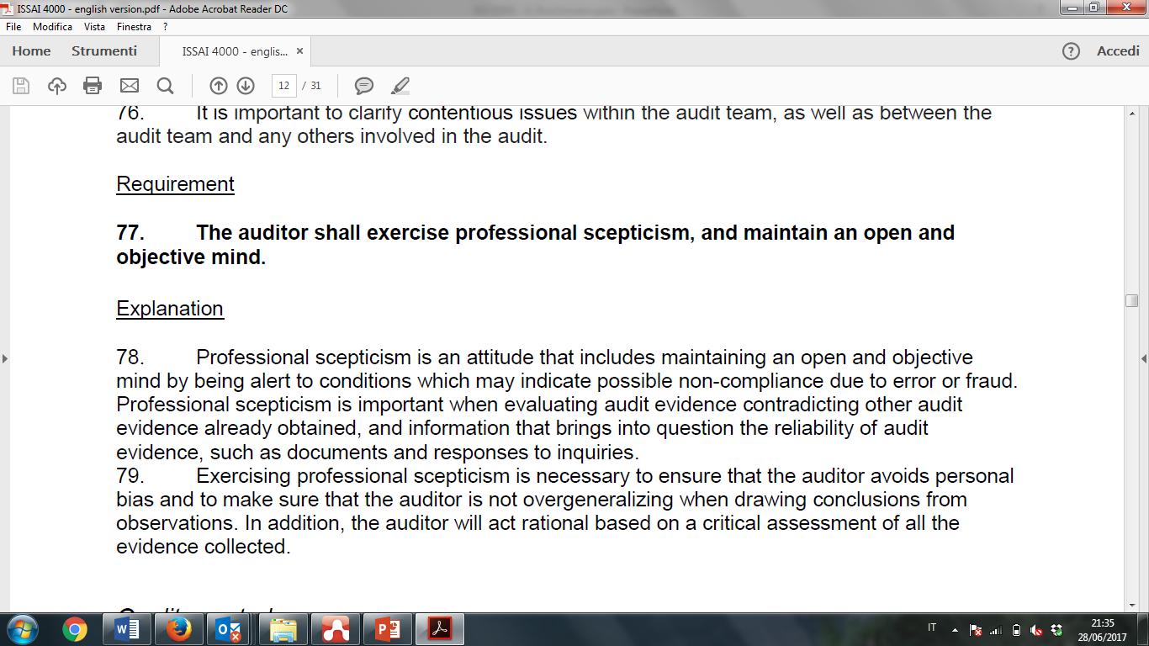
Notes:
8

Slide 9
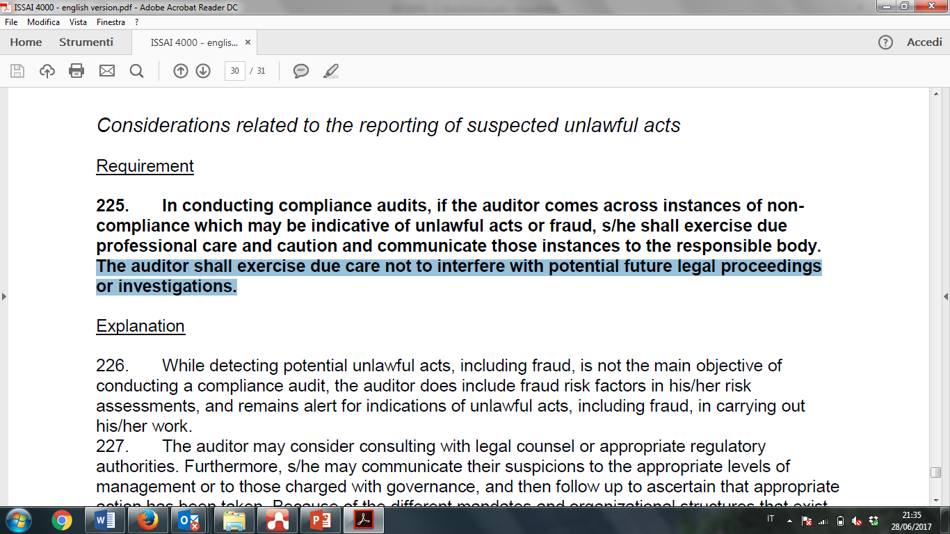
Notes:
9

Slide 10
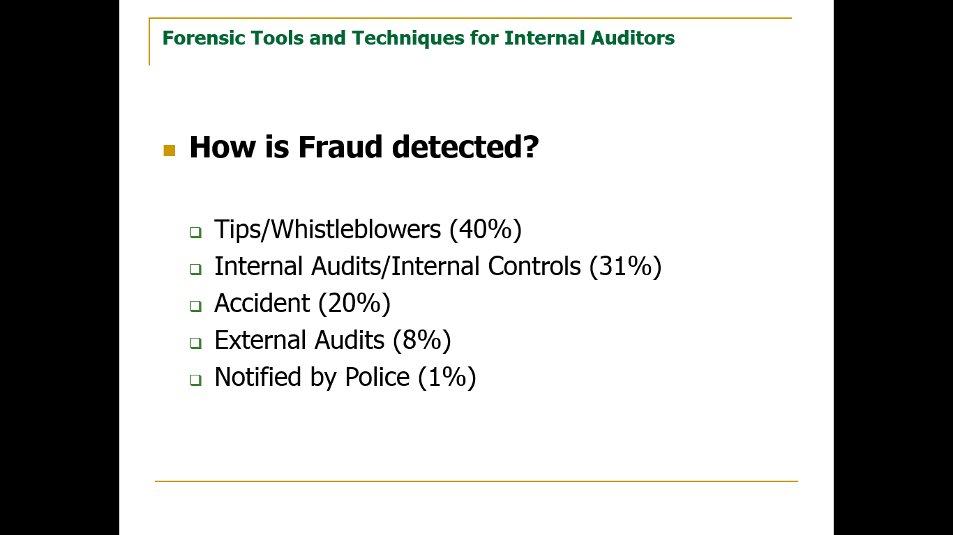
Notes:
10

Slide 11
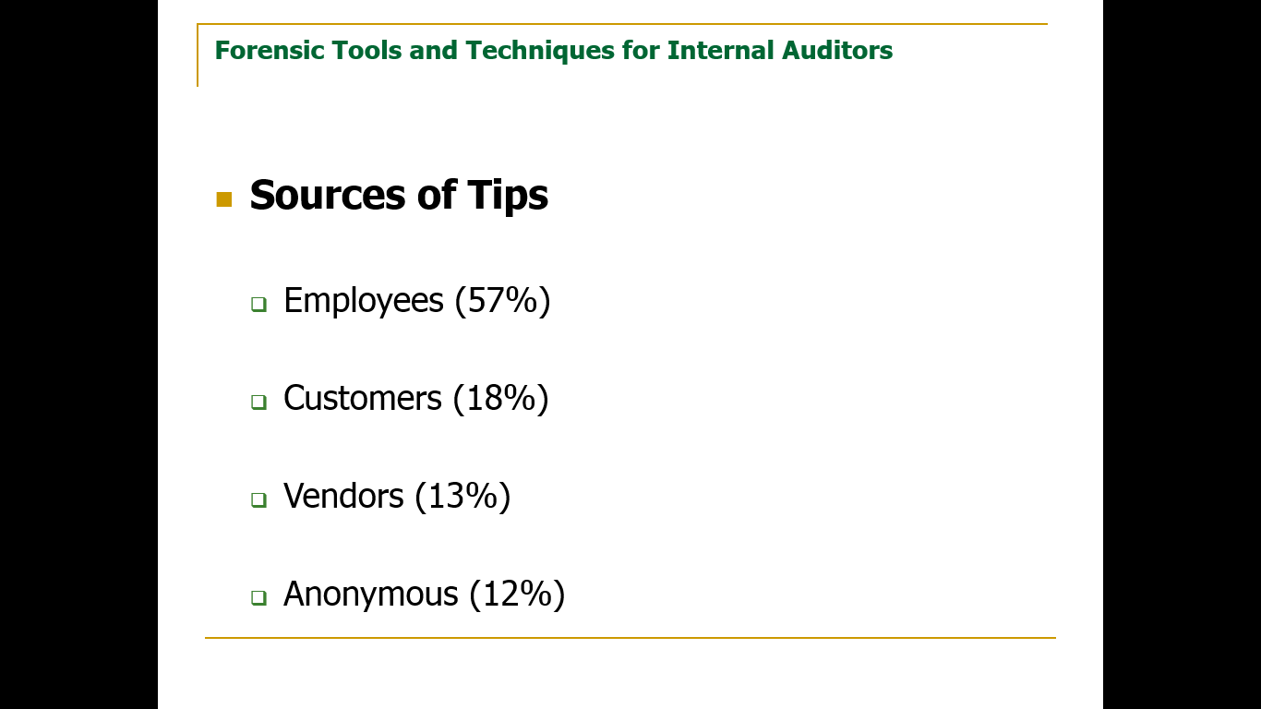
Notes:
11

Slide 12
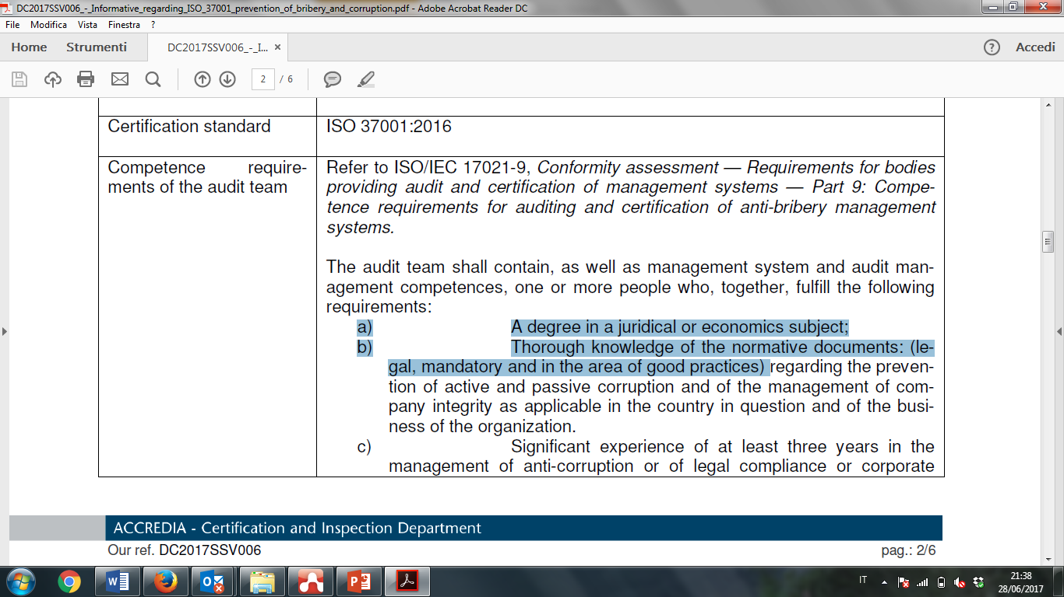
Notes:
12

Slide 13
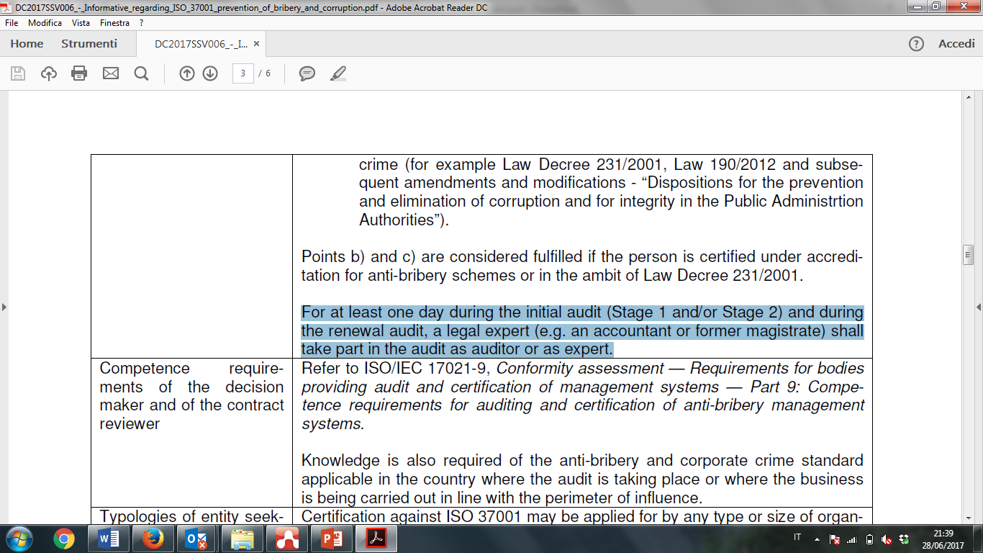
Notes:
13

Slide 14
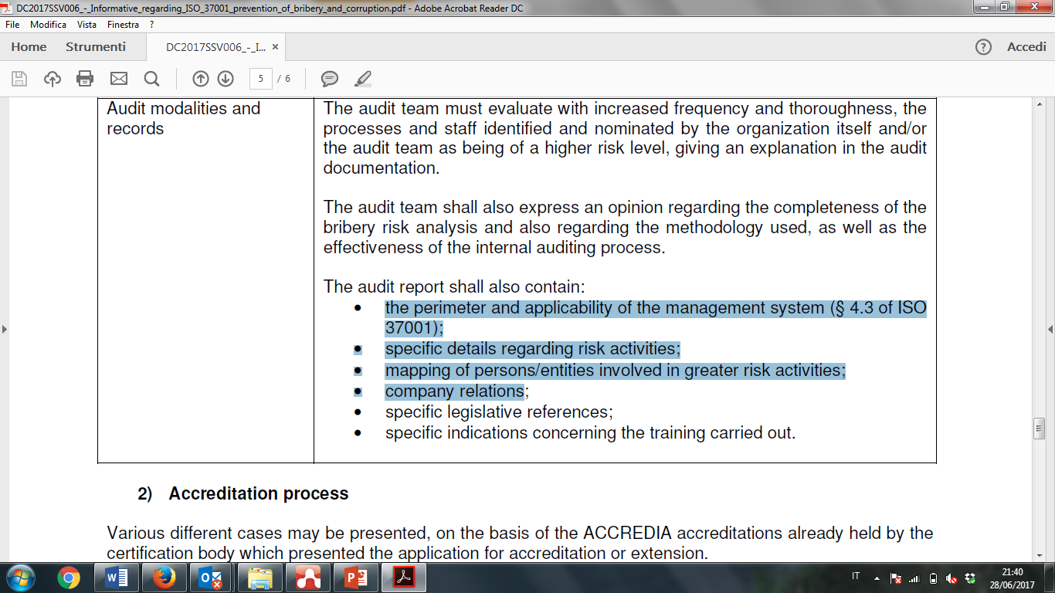
Notes:
14

Slide 15
Cosa viene certificato? Dove mettiamo il confine?
Networks, fiduciarie, partners….
Very difficult to determine the boundaries of the MS, when there are sister or linked companies, or shares in other companies, or companies linked to the owners of the companies
The audit team needfull power to investigate in the network of the companies, in order to follow the stream of the money (mostly if located in risky contries)
It is required high transparency ano openess in the company under evaluation.
Notes:
15

Slide 16
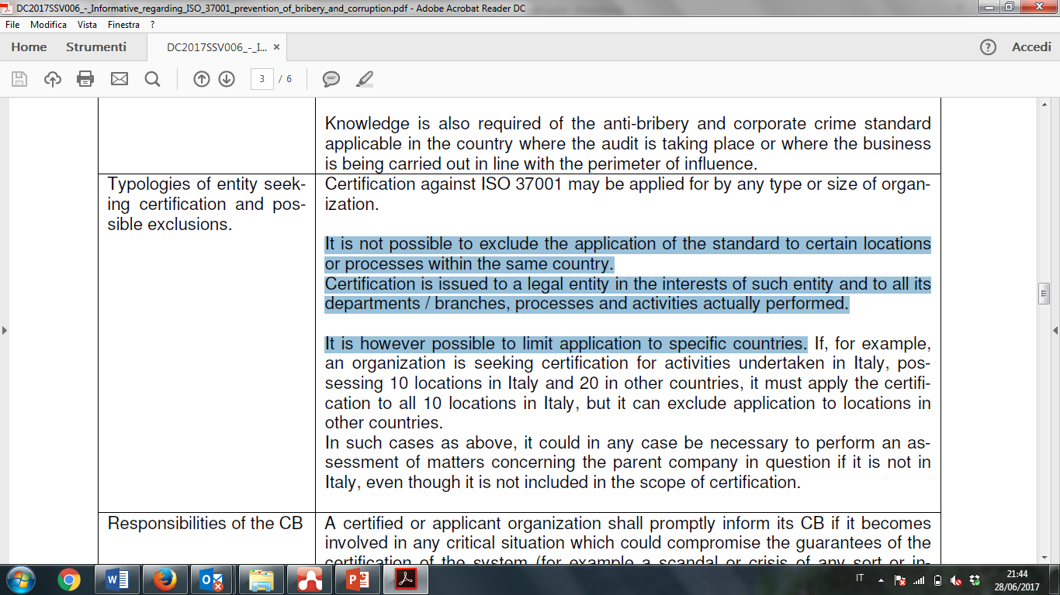
Notes:
16

Slide 17
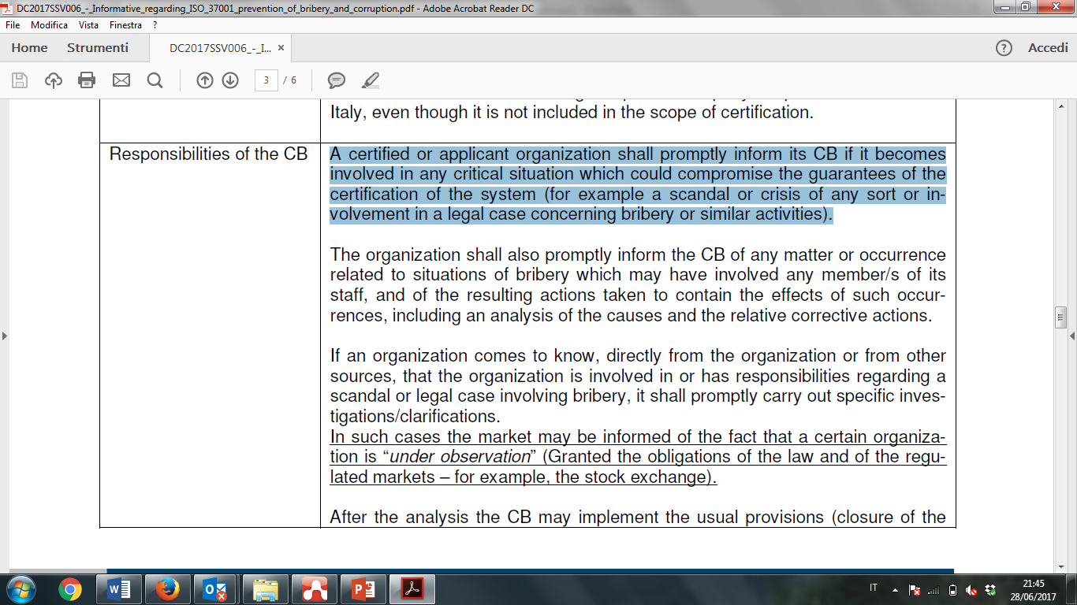
Notes:
17

Slide 18
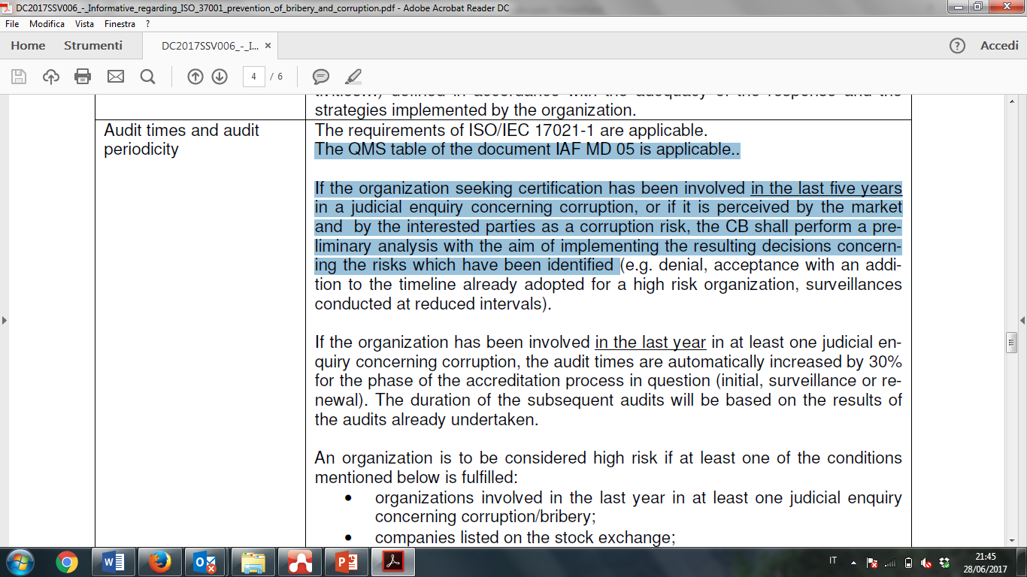
Notes:
18

Slide 19
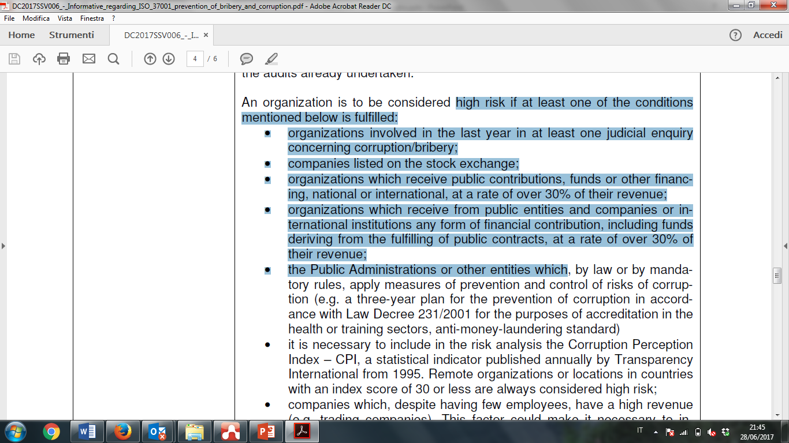
Notes:
19

Slide 20
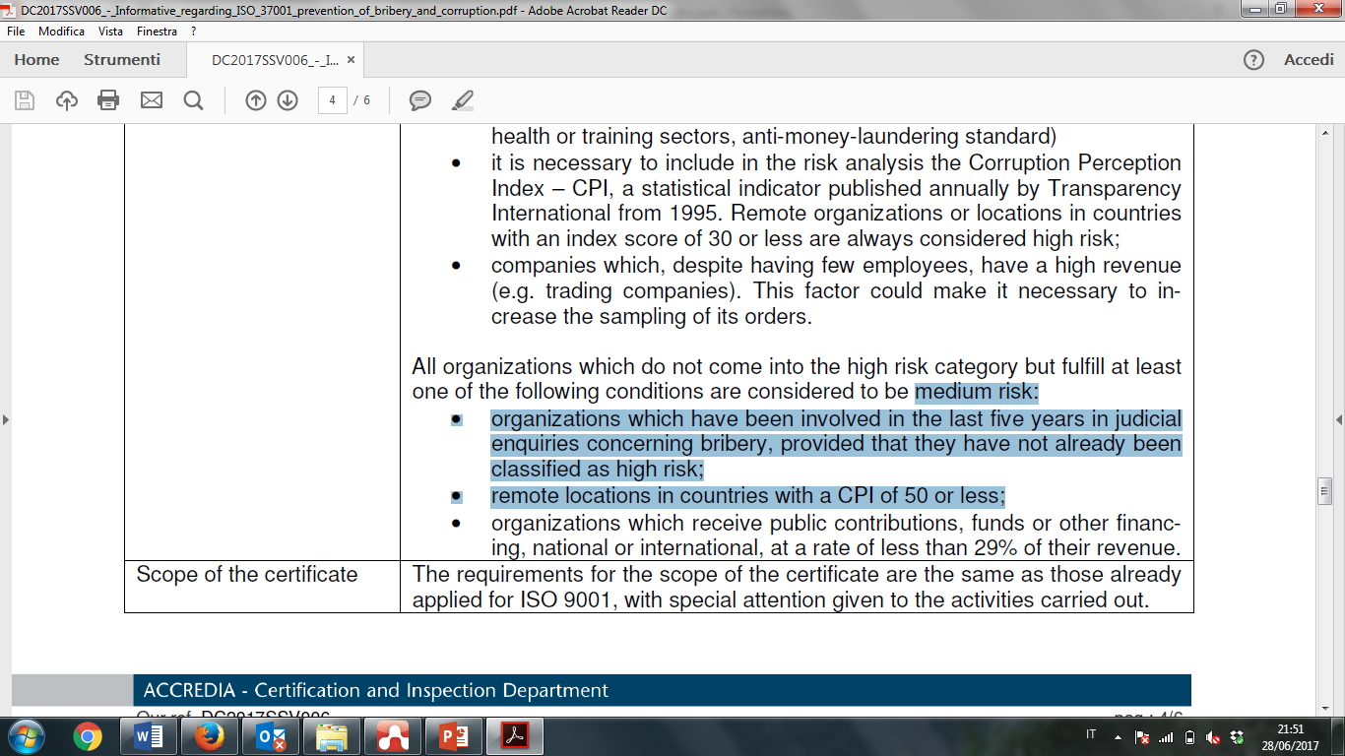
Notes:
20

Slide 21
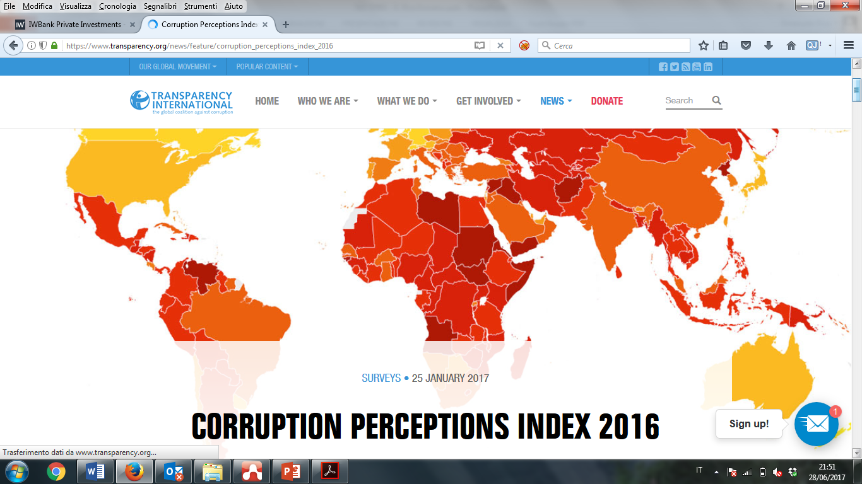
Notes:
21

Slide 22
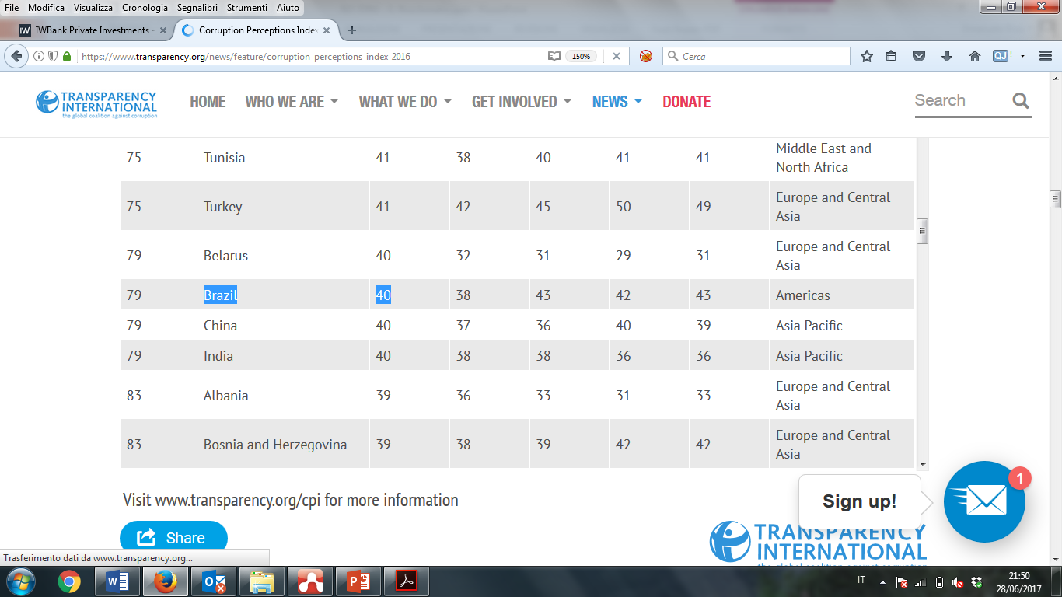
Notes:
22

Slide 23
ACCREDIA L’ente italiano di accreditamento
Thanks for your kind attention
www.accredia.it
info@accredia.it

